Slide 1
Resilient İzmir: Seismic Risk and Urban Systems Vulnerability Assessment
Executive Summary Presentation (ToR T10)
İzmir Disaster Resilience Advisory Team

Slide 2
1. Introduction and Project Framework
Resilient İzmir: Urban Vulnerability and Systems Assessment
Objective: Apply a tiered screening and spatial decision-support methodology to assess earthquake and cascading multi-hazard risks across İzmir.
Scope: Macro-screening across 1,317 neighbourhoods (Tier A) and high-priority deep dive across 3 focal districts—Bayraklı, Bornova, and Konak (Tier B).
Institutional Setup: Coordinated by AFAD (Disaster and Emergency Management Presidency) and the World Bank; integrated with İzmir Metropolitan Municipality GIS data.
Financing and Visibility: This activity is financed by the European Union through the Technical Assistance Financing Facility (TAFF) and implemented by the World Bank, in coordination with AFAD.

Slide 3
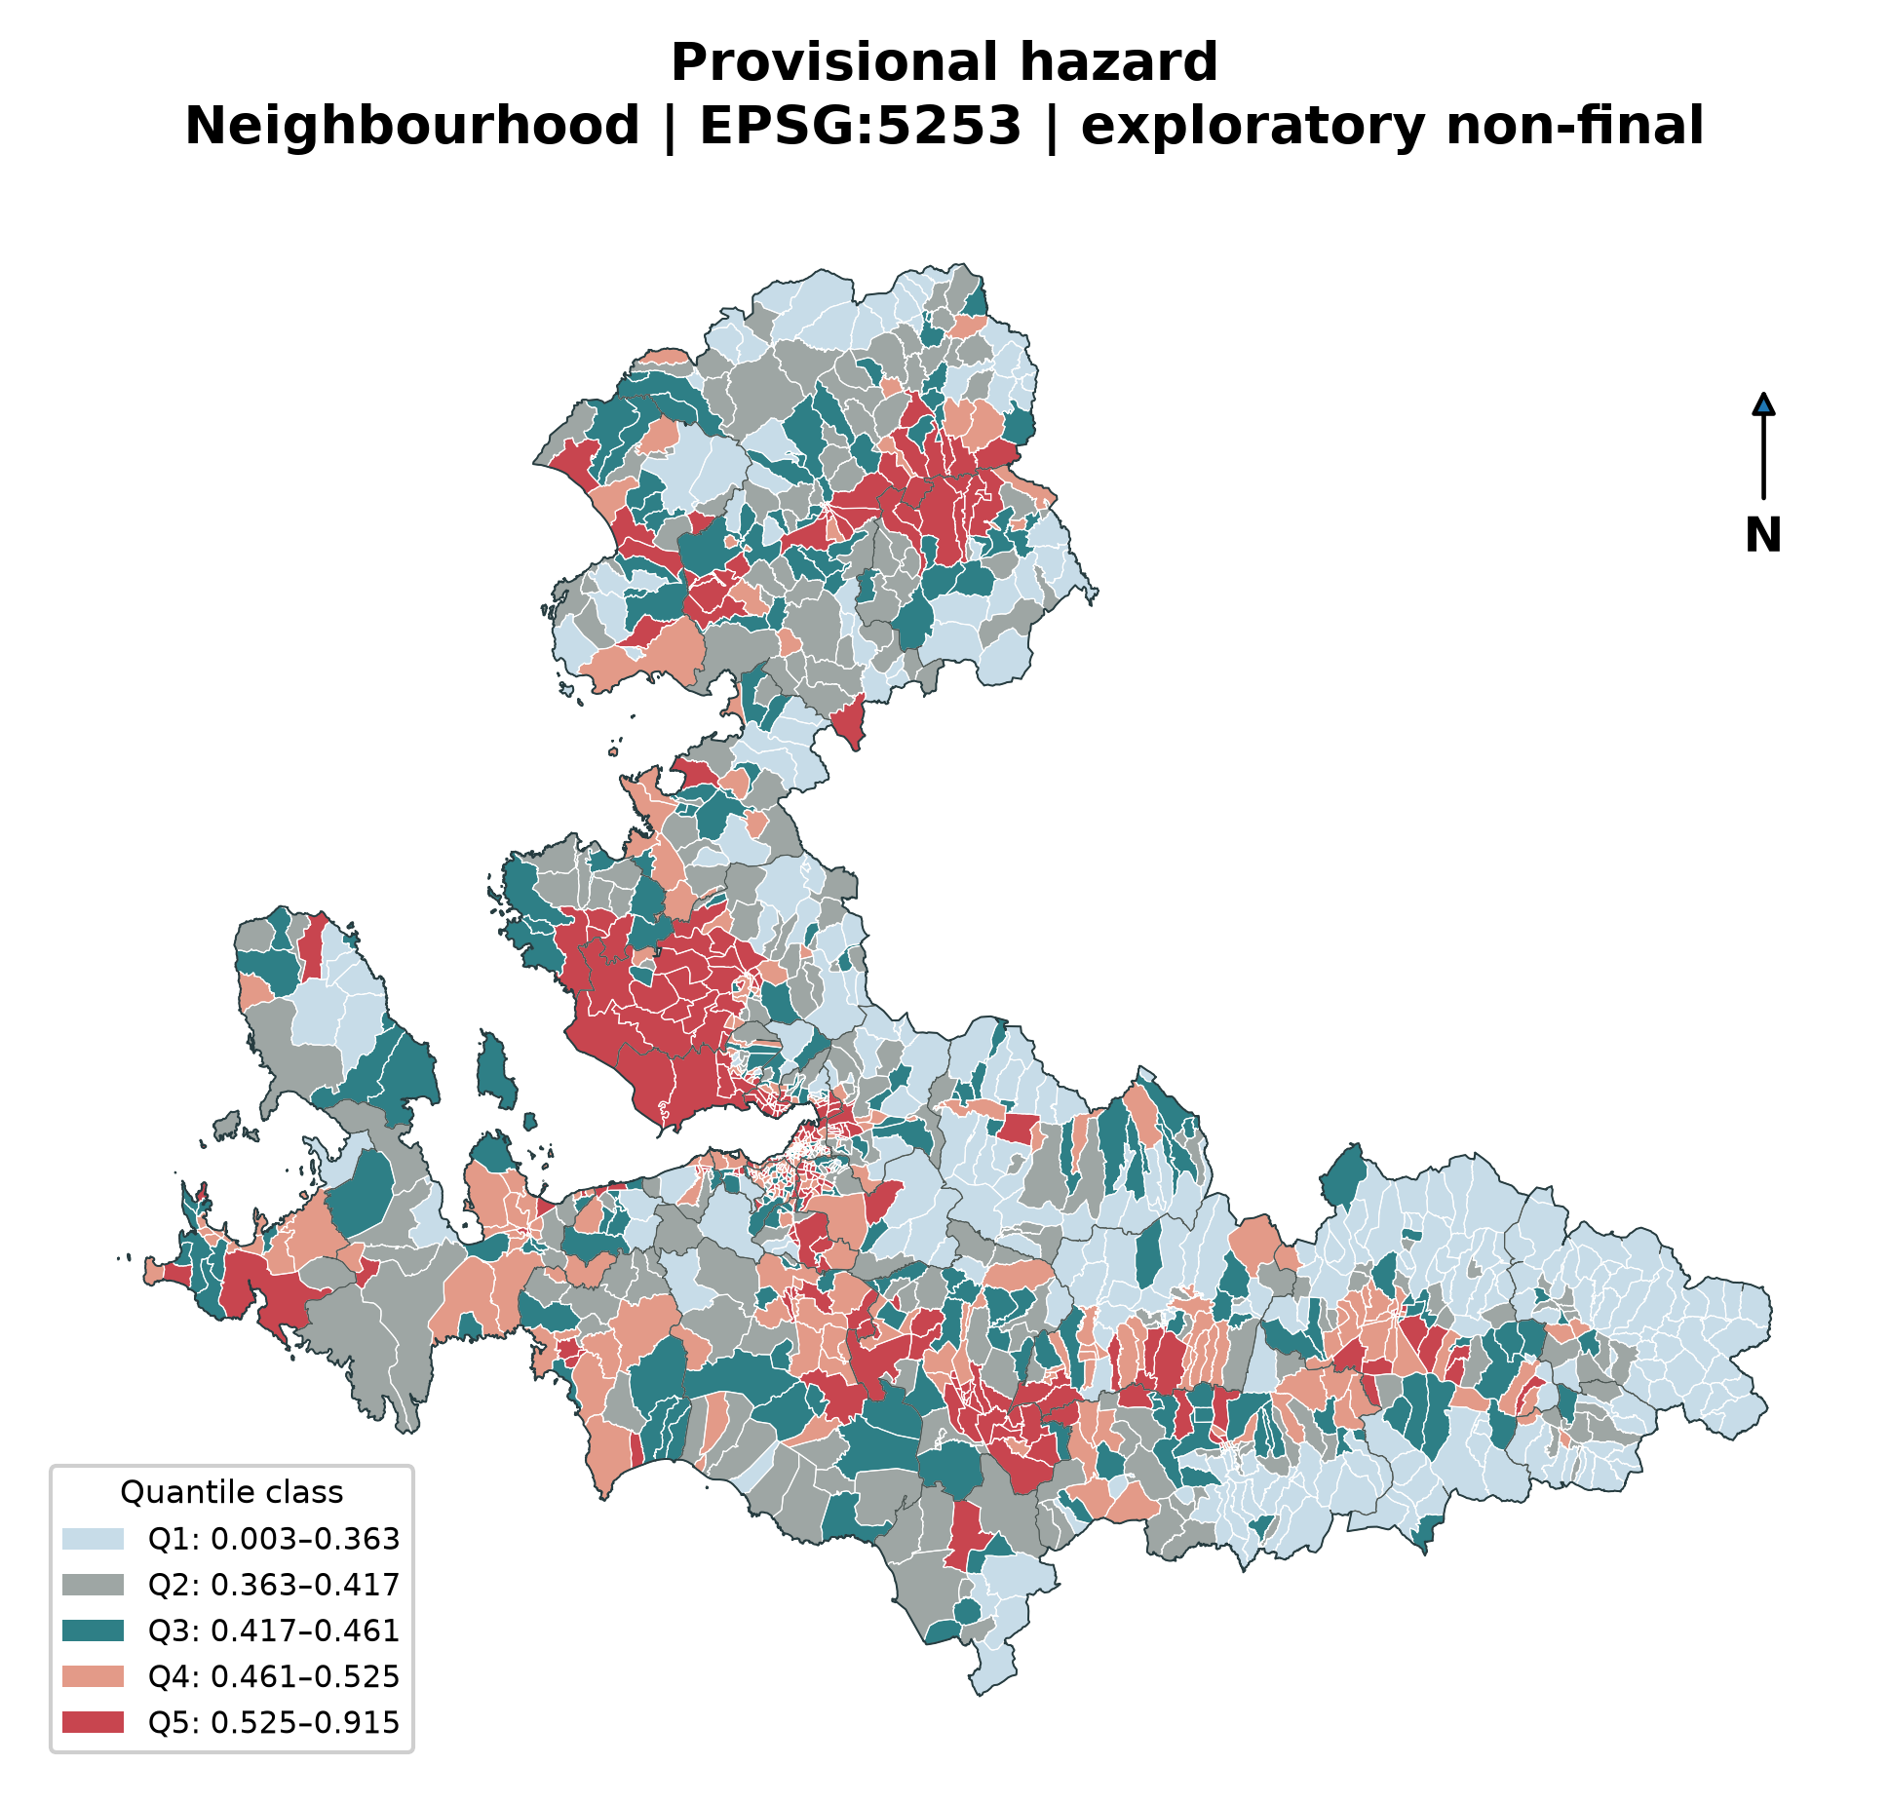
2. Why İzmir? Multi-Hazard Profile & 2020 Lessons

Slide 4
Tectonic Setting: High seismic hazard driven by the İzmir Fault, Gülbahçe, Seferihisar, Tuzla, and Menemen active fault systems.
October 30, 2020 Samos–İzmir Earthquake: Although the epicentre was over 70 km away, deep alluvial basin amplification caused 117 fatalities and heavy damage to 739 buildings in Bayraklı and Bornova.
Multi-Hazard Drivers: Strong ground motion compounded by coastal liquefaction susceptibility, potential tsunami wave inundation, and slope instability in hilly settlements.

Slide 5
3. Tiered Methodology & Multi-Criteria Decision Framework
Tier A (Metropolitan Screening): Comprehensive comparative ranking of all 30 districts and 1,317 neighbourhoods across 5 resilience dimensions.
Tier B (Focal Deep-Dive): Building-level structural vulnerability assessment protocol designed for Bayraklı, Bornova, and Konak.
F-BWM (Fuzzy Best-Worst Method): 15-expert interdisciplinary panel weights:
  Hazard (H): 22.6%
  Structural Vulnerability (S): 19.7%
  Network / Lifeline Vulnerability (N): 19.4%
  Exposure (E): 20.3%
  Capacity Shortfall (C): 18.1%
  Consistency Ratio: $ξ^{*}=0.0257≤0.10$ (high consistency across all experts).

Slide 6
4. Data Reality & Evidence Grading
Grade A (Official Authoritative GIS Layers):
  İzmir Metropolitan Municipality 1,317 neighbourhood polygons and address points.
  207,257 road centreline segments and 7,530 green space polygons in EPSG:5253.
Grade B (Proxy and Derived Indicators):
  TurkStat 2023 neighbourhood population (preserving 513 disclosure-suppressed units).
  SRTM / ALOS DSM elevation and slope; USGS/Global Vs30 ground stiffness proxy.
Grade C / Critical Data Gaps (AFAD Formal Request List):
  High-resolution microzonation Vs30 and liquefaction potential maps.
  Refined active fault buffer zones and surface rupture avoidance polygons.
  Field-verified emergency shelter capacity and utility inventory per person.

Slide 7
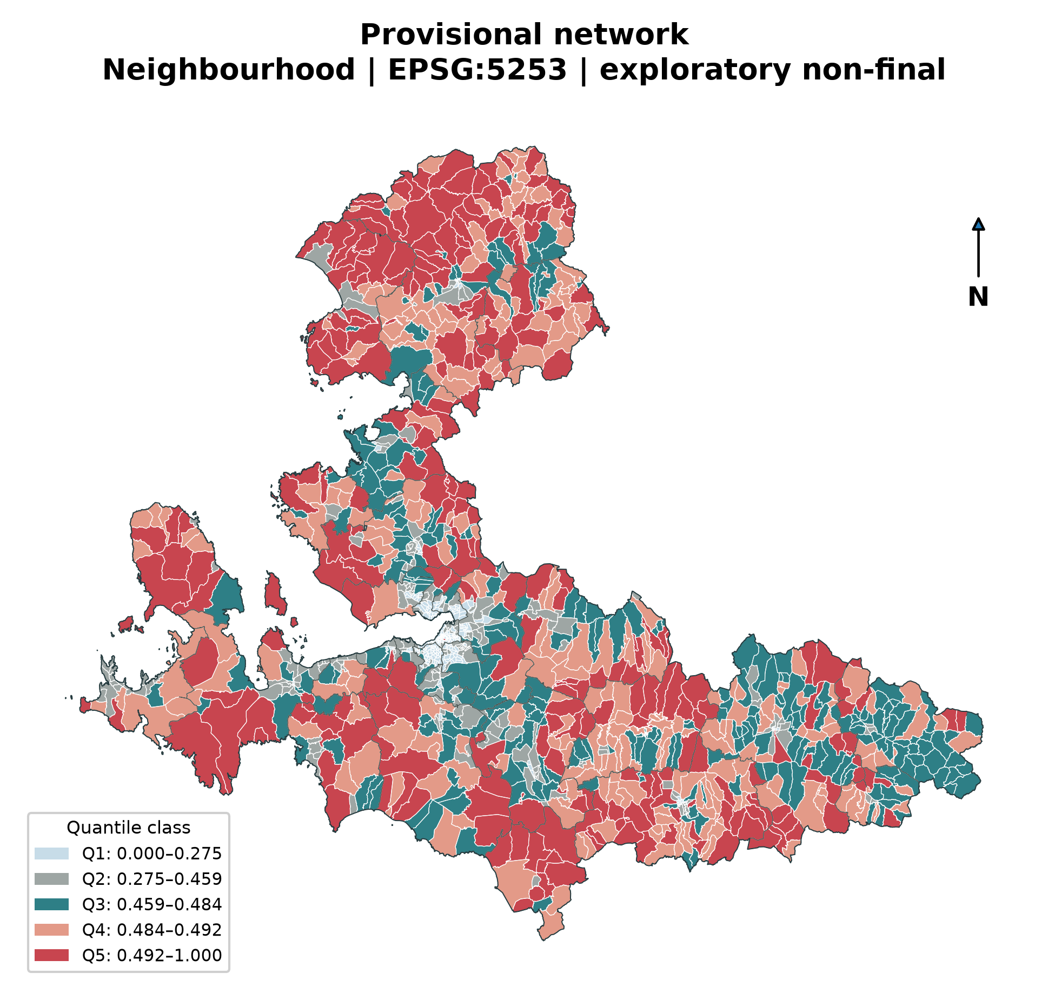
5. Lifeline & Transport Network Vulnerability

Slide 8
Network Topology: 149,798 nodes and 207,257 edges analysed with 1 m endpoint tolerance; 517 connected components identified.
Single Points of Failure (SPoF): Narrow coastal and rail-adjacent choke points (especially Konak–Alsancak and Bayraklı–Turan) threaten to sever metropolitan connectivity under structural collapse.
Accessibility Analysis: 5, 10, and 15-minute reachability buffers mapped for 71 designated assembly areas; inner hillside neighbourhoods show acute pedestrian deficits.

Slide 9
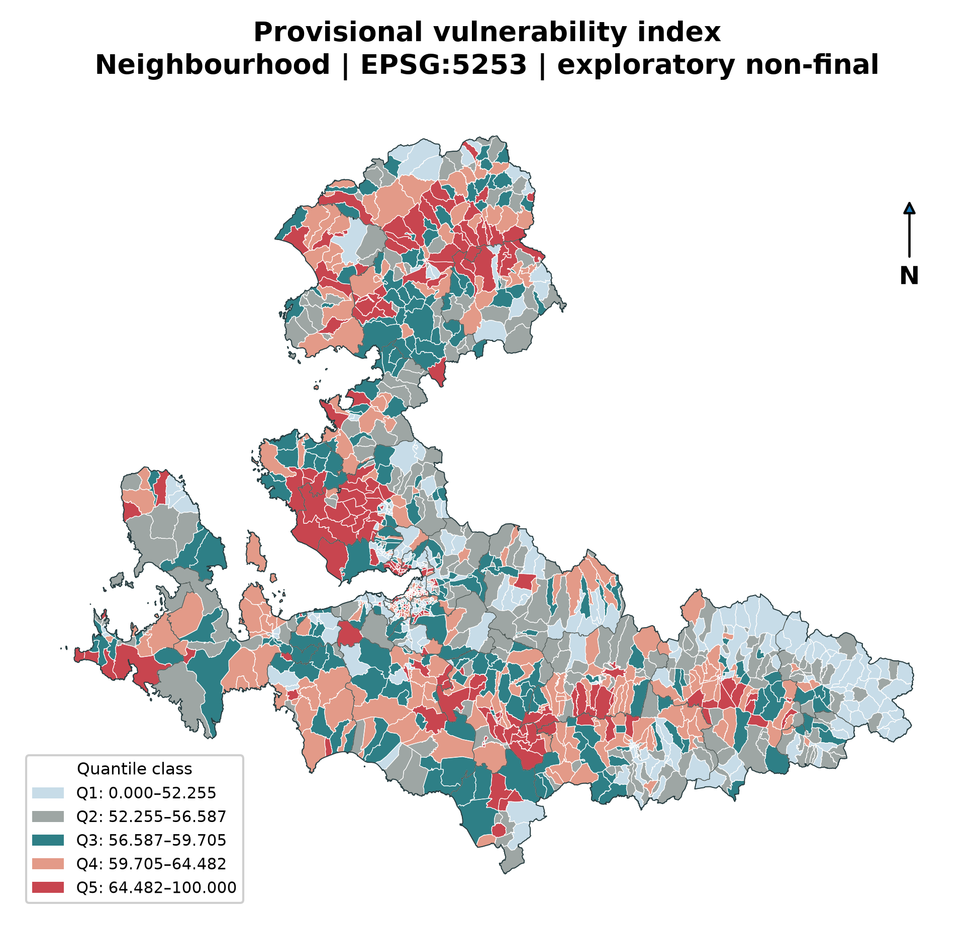
6. Spatial Priority Map (Priority Index Hotspots)

Slide 10
Spatial Autocorrelation (LISA): Statistically significant ($p<0.05$) high-risk clusters (High-High) identified via Local Moran’s I across 1,317 neighbourhoods.
Robustness Check: 126 core hotspot neighbourhoods remain stable across both Queen contiguity and KNN-8 spatial weight matrices.
Getis-Ord Gi* Hotspots: $Z>+2.58$ concentrations clearly highlight the combination of soft alluvial soils, dense building footprints, and evacuation bottlenecks.

Slide 11
7. Priority Zones & Dominant Drivers
Zone 1: Bayraklı – Bornova Basin
  Drivers: Deep alluvial basin amplification + pre-1999 multi-storey reinforced concrete buildings + high population density.
Zone 2: Konak – Karabağlar Historic Core
  Drivers: Narrow street geometry prone to debris blockage + high density of vulnerable stone/masonry buildings + shelter deficits.
Zone 3: Karşıyaka – Çiğli Coastal Strip
  Drivers: Severe liquefaction susceptibility + shallow water table + potential tsunami inundation risk.
Zone 4: Menemen – Kemalpaşa Industrial & Transport Corridors
  Drivers: Rapid industrial expansion, hazardous material (BEKRA) sites + vulnerability to highway network disconnection.

Slide 12
8. Action Strategies: No-Regret & Quick-Win Measures
No-Regret / Quick-Win Packages:
  Assembly Area Standardisation: Equipping 71 primary open spaces with autonomous water, solar microgrids, and satellite communication.
  Arterial Corridor Protection: Establishing building set-back enforcement ($≥1.5×$ street width) and debris clearance routing along vital routes.
  Shared GIS Resilience Clearinghouse: Deploying an inter-agency spatial data platform connecting AFAD, İzmir Municipality, and utilities.
Structural Interventions:
  Targeted seismic retrofitting of critical public facilities (hospitals, fire stations, schools).
  Area-based urban renewal incentives focused on the 126 core hotspot neighbourhoods.

Slide 13
9. Feasibility & Rapid Economic Assessment
5-Dimensional Feasibility Index:
  Technical feasibility, financial cost-effectiveness, institutional mandate clarity, social acceptability, and environmental impact ($F_{i}∈[0,100]$).
Triple Dividend Framework:
  1st Dividend: Direct avoidance of lives lost, injuries, and structural reconstruction costs during earthquakes.
  2nd Dividend: Unlocking economic productivity, investment security, and property value stability during non-disaster times.
  3rd Dividend: Co-benefits from green open spaces, stormwater drainage, and enhanced everyday public transit corridors.
Benefit-Cost Ratio (BCR): Indicative BCR for prioritised packages ranges between 1.5 and 2.2.

Slide 14
10. Phased Investment Roadmap
Phase 1 (0 – 6 Months) / Immediate Actions & Data Finalisation:
  Formalise data-sharing protocols with AFAD for Tier B structural building attributes.
  Eliminate bottlenecks on emergency corridors and install standardized signage at all 71 assembly sites.
Phase 2 (6 – 18 Months) / Infrastructure & Network Hardening:
  Seismic retrofitting of key bridges, flyovers, and lifelines along the Gulf transport axis.
  Install autonomous backup water and solar microgrid units at designated emergency hubs.
Phase 3 (18 – 36 Months) / Area-Based Urban Renewal:
  Roll out targeted structural retrofitting and redevelopment programs financed via World Bank / TAFF facilities.

Slide 15
11. Strategic Disaster Resilience Recommendations
Inputs to the İzmir Urban Disaster Resilience Strategy:
  Adopt the neighbourhood-level Priority Index as the spatial foundation for the Municipal 2025–2029 Strategic Investment Plan.
  Align municipal and utility capital expenditure (İZSU, GDZ Electricity, İzmirgaz) with designated spatial hotspots.
Dynamic Risk Monitoring System:
  Institutionalise the automated Python GIS analytics pipeline (resilient_izmir) for annual indicator updates using TurkStat and building registry data.
  Establish a formal spatial data agreement and open-access metadata catalog.

Slide 16
12. Thanks & Contacts
Resilient İzmir Study Team
Contact: resilient.izmir@afad.gov.tr | project-desk@worldbank.org
Repository: C:\Users\YE\PyCharmMiscProject\resilient_izmir
Disclaimer & Visibility:
This activity is financed by the European Union through the Technical Assistance Financing Facility (TAFF) and implemented by the World Bank, in coordination with the Disaster and Emergency Management Presidency (AFAD). The contents of this document are the sole responsibility of the author(s) and do not necessarily reflect the views of the European Union or the World Bank.

